Slide 1
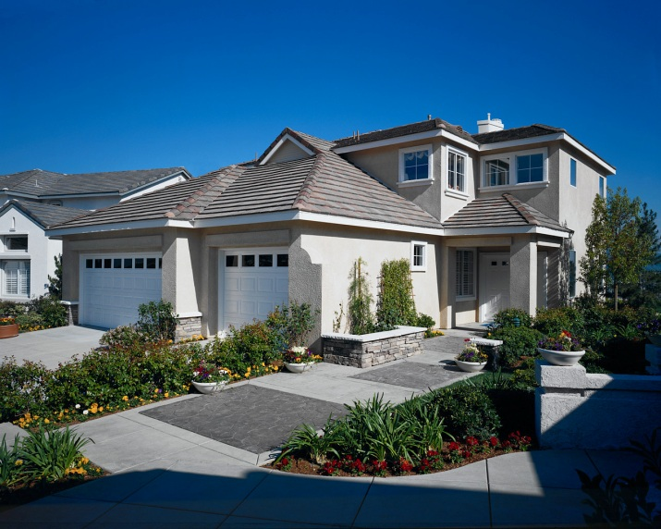

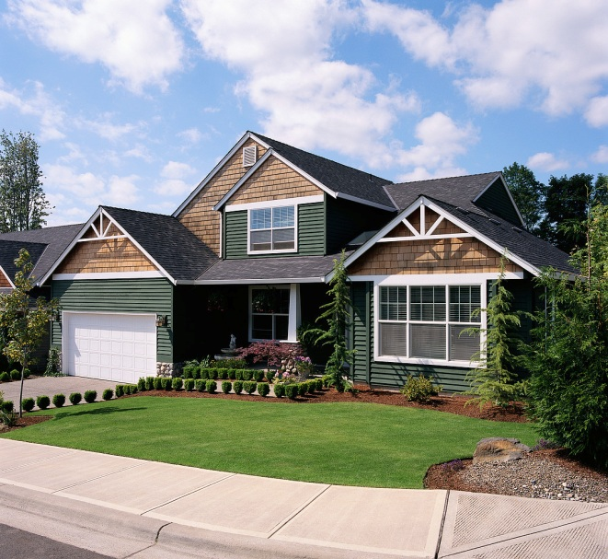

Case Study: Real Estate
Marie Rodriguez STAT 51200

Slide 2
Purpose
The goal of this case study is to create a multiple linear regression model that can be used to predict the total price of an apartment (y) by its area in ft²(x₁), age in years(x₂), floor level(x₃), number of rooms(x₄), number of toilets(x₅), and whether or not it has its own garage, elevator, or trash pickup (x₆, x₇, and x₈).
This data was taken from a study done in 2005 from a sample of 218 apartments.

Slide 3
Model 1 (full model)
model1=lm(y~x₁+x₂+x₃+x₄+x₅+x₆+x₇+x₈)
This yields the following multiple linear regression model:
y=60337.3+2007.8x₁-490.2x₂-1752.3x₃ +105.2x₄+19254.5x₅+28371.6x₆+20186.2x₇+9983.8x₈

Slide 4
Analysis of Variance of Model 1
> anova(model1)
Analysis of Variance Table
Response: y
Df Sum Sq Mean Sq F value Pr(>F)
x1 1 6.8239e+11 6.8239e+11 624.6974 < 2.2e-16 ***
x2 1 5.5354e+10 5.5354e+10 50.6741 1.720e-11 ***
x3 1 3.1489e+09 3.1489e+09 2.8827 0.091026 .
x4 1 6.5691e+06 6.5691e+06 0.0060 0.938262
x5 1 3.0347e+10 3.0347e+10 27.7816 3.375e-07 ***
x6 1 2.9227e+10 2.9227e+10 26.7562 5.394e-07 ***
x7 1 1.0227e+10 1.0227e+10 9.3624 0.002505 **
x8 1 3.0925e+09 3.0925e+09 2.8311 0.093951 .
Residuals 209 2.2830e+11 1.0924e+09
---
Signif. codes: 0 ‘***’ 0.001 ‘**’ 0.01 ‘*’ 0.05 ‘.’ 0.1 ‘ ’ 1

Slide 5
Summary of Model 1
> summary(model1)
Call:
lm(formula = y ~ x1 + x2 + x3 + x4 + x5 + x6 + x7 + x8)
Residuals:
Min 1Q Median 3Q Max
-91482 -20305 -888 15562 99408
Coefficients:
Estimate Std. Error t value Pr(>|t|)
(Intercept) 60337.3 19295.1 3.127 0.00202 **
x1 2007.8 169.4 11.855 < 2e-16 ***
x2 -490.2 178.9 -2.741 0.00666 **
x3 -1752.3 1101.3 -1.591 0.11309
x4 105.2 4684.5 0.022 0.98210
x5 19254.5 6407.9 3.005 0.00298 **
x6 28371.6 5690.5 4.986 1.29e-06 ***
x7 20186.2 6974.7 2.894 0.00420 **
x8 9983.8 5933.6 1.683 0.09395 .
---
Signif. codes: 0 ‘***’ 0.001 ‘**’ 0.01 ‘*’ 0.05 ‘.’ 0.1 ‘ ’ 1
Residual standard error: 33050 on 209 degrees of freedom
Multiple R-squared: 0.7809, Adjusted R-squared: 0.7725
F-statistic: 93.12 on 8 and 209 DF, p-value: < 2.2e-16

Slide 6
Note that the coefficient of determination (R² ) of the full model is 0.7809. This means that using the variables area, age, floor level, number of rooms, toilets, garages, elevators, and trash pickup in a ﬁrst order model explains approximate 78.09% of the total sample variation of the total price.

Slide 7
Variance Inflation Factors
> vif(model1)
x1 x2 x3 x4 x5 x6 x7 x8
2.449263 1.353927 1.089966 1.753852 2.040182 1.307747 1.563984 1.157369
After examining the VIFs of each x_{i}, we see that each VIF_{i} is much less than 5. Therefore, we conclude that there does not exist a multicollinearity problem.

Slide 8
AIC and BIC of Model 1
> AIC(model1)
[1] 5166.395
> BIC(model1)
[1] 5200.24

Slide 9

Backward Elimination Method ($α=0.05)$
> summary(model1)$coefficients
Estimate Std. Error t value Pr(>|t|)
(Intercept) 60337.2958 19295.1357 3.12707289 2.017030e-03
x1 2007.7831 169.3597 11.85513839 3.939910e-25
x2 -490.2383 178.8658 -2.74081691 6.659289e-03
x3 -1752.2569 1101.2672 -1.59112789 1.130922e-01
x4 105.2450 4684.5049 0.02246663 9.820972e-01
x5 19254.4522 6407.8861 3.00480561 2.982364e-03
x6 28371.6123 5690.5140 4.98577321 1.294259e-06
x7 20186.2415 6974.6852 2.89421540 4.204266e-03
x8 9983.7573 5933.6238 1.68257335 9.395102e-02
Note that x₄ has the largest p-value so we eliminate it from the model.

Slide 10
> model2=lm(y~x1+x2+x3+x5+x6+x7+x8)
> summary(model2)$coefficients
Estimate Std. Error t value Pr(>|t|)
(Intercept) 60666.0982 12544.4095 4.836106 2.557854e-06
x1 2009.7277 145.2256 13.838661 2.207601e-31
x2 -490.3563 178.3627 -2.749209 6.494490e-03
x3 -1750.9093 1097.0126 -1.596070 1.119768e-01
x5 19256.2206 6392.1365 3.012486 2.909449e-03
x6 28366.3674 5672.1765 5.000967 1.202412e-06
x7 20205.5695 6904.9334 2.926251 3.808203e-03
x8 9970.2605 5889.0694 1.693011 9.193623e-02
Note that x₃ has the largest p-value so we eliminate it from the model.

Slide 11
> model3=lm(y~x1+x2+x5+x6+x7+x8)
> summary(model3)$coefficients
Estimate Std. Error t value Pr(>|t|)
(Intercept) 53750.8705 11815.5271 4.549172 9.081232e-06
x1 2007.4870 145.7503 13.773464 3.257040e-31
x2 -479.3724 178.8822 -2.679821 7.947493e-03
x5 18674.0290 6405.0789 2.915503 3.934608e-03
x6 29267.6201 5664.6582 5.166705 5.507363e-07
x7 18251.9365 6820.4501 2.676060 8.034212e-03
x8 11599.7323 5821.1294 1.992694 4.758357e-02
Here we see that x₈ has largest p-value. However, 0.04758357<0.05. Therefore, we have our new model.

Slide 12
Model 2
> model2
Call:
lm(formula = y ~ x1 + x2 + x5 + x6 + x7 + x8)
Coefficients:
(Intercept) x1 x2 x5 x6 x7
53750.9 2007.5 -479.4 18674.0 29267.6 18251.9
x8
11599.7
So, after using the backward elimination process, we get the fitted model y=53750.9+2007.5x1-479.4x2+18674x₅+29267.6x₆+18251x₇+11599.7x₈.

Slide 13
Summary of Model 2
> summary(model2)
Call:
lm(formula = y ~ x1 + x2 + x5 + x6 + x7 + x8)
Residuals:
Min 1Q Median 3Q Max
-90945 -18535 -2678 16497 100648
Coefficients:
Estimate Std. Error t value Pr(>|t|)
(Intercept) 53750.9 11815.5 4.549 9.08e-06 ***
x1 2007.5 145.8 13.773 < 2e-16 ***
x2 -479.4 178.9 -2.680 0.00795 **
x5 18674.0 6405.1 2.916 0.00393 **
x6 29267.6 5664.7 5.167 5.51e-07 ***
x7 18251.9 6820.5 2.676 0.00803 **
x8 11599.7 5821.1 1.993 0.04758 *
---
Signif. codes: 0 ‘***’ 0.001 ‘**’ 0.01 ‘*’ 0.05 ‘.’ 0.1 ‘ ’ 1
Residual standard error: 33090 on 211 degrees of freedom
Multiple R-squared: 0.7783, Adjusted R-squared: 0.772
F-statistic: 123.4 on 6 and 211 DF, p-value: < 2.2e-16
Note that the adjusted R² only decreased by 0.0005.

Slide 14
AIC and BIC of Model 2
> AIC(model2)
[1] 5165.024
> BIC(model2)
[1] 5192.1

Slide 15

Forward Selection Method ($α=0.05)$
> add1(lm(y~1),scope=(~.+x1+x2+x3+x4+x5+x6+x7+x8),test="F")
Single term additions
Model:
y ~ 1
Df Sum of Sq RSS AIC F value Pr(>F)
<none> 1.0421e+12 4860.7
x1 1 6.8239e+11 3.5970e+11 4630.8 409.7694 < 2.2e-16 ***
x2 1 7.7353e+10 9.6474e+11 4845.9 17.3190 4.563e-05 ***
x3 1 8.8974e+08 1.0412e+12 4862.5 0.1846 0.6679
x4 1 2.8791e+11 7.5418e+11 4792.2 82.4595 < 2.2e-16 ***
x5 1 4.9265e+11 5.4944e+11 4723.2 193.6754 < 2.2e-16 ***
x6 1 2.8585e+11 7.5624e+11 4792.8 81.6462 < 2.2e-16 ***
x7 1 2.7205e+11 7.7005e+11 4796.8 76.3102 6.764e-16 ***
x8 1 7.4489e+10 9.6760e+11 4846.6 16.6283 6.393e-05 ***
---
Signif. codes: 0 ‘***’ 0.001 ‘**’ 0.01 ‘*’ 0.05 ‘.’ 0.1 ‘ ’ 1
Note that x₁ has the smallest p-value so it will be added in the model.

Slide 16
> add1(lm(y~1+x1),scope=(~.+x2+x3+x4+x5+x6+x7+x8),test="F")
Single term additions
Model:
y ~ 1 + x1
Df Sum of Sq RSS AIC F value Pr(>F)
<none> 3.5970e+11 4630.8
x2 1 5.5354e+10 3.0435e+11 4596.4 39.1032 2.137e-09 ***
x3 1 1.4251e+09 3.5828e+11 4632.0 0.8552 0.3561201
x4 1 1.4929e+08 3.5956e+11 4632.8 0.0893 0.7653963
x5 1 5.6364e+10 3.0334e+11 4595.7 39.9496 1.482e-09 ***
x6 1 6.8073e+10 2.9163e+11 4587.1 50.1857 1.968e-11 ***
x7 1 4.5308e+10 3.1440e+11 4603.5 30.9839 7.706e-08 ***
x8 1 2.2452e+10 3.3725e+11 4618.8 14.3132 0.0002007 ***
---
Signif. codes: 0 ‘***’ 0.001 ‘**’ 0.01 ‘*’ 0.05 ‘.’ 0.1 ‘ ’ 1
Note that x₆ has the smallest p-value so it will be added in the model.

Slide 17
> add1(lm(y~1+x1+x6),scope=(~.+x2+x3+x4+x5+x7+x8),test="F")
Single term additions
Model:
y ~ 1 + x1 + x6
Df Sum of Sq RSS AIC F value Pr(>F)
<none> 2.9163e+11 4587.1
x2 1 3.4137e+10 2.5750e+11 4562.0 28.3703 2.529e-07 ***
x3 1 4.5150e+08 2.9118e+11 4588.8 0.3318 0.5651913
x4 1 3.5681e+08 2.9127e+11 4588.8 0.2622 0.6091747
x5 1 2.6384e+10 2.6525e+11 4568.4 21.2861 6.810e-06 ***
x7 1 3.0487e+10 2.6114e+11 4565.0 24.9829 1.202e-06 ***
x8 1 1.4780e+10 2.7685e+11 4577.8 11.4244 0.0008614 ***
---
Signif. codes: 0 ‘***’ 0.001 ‘**’ 0.01 ‘*’ 0.05 ‘.’ 0.1 ‘ ’ 1
Note that x₂ has the smallest p-value so it will be added in the model.

Slide 18
> add1(lm(y~1+x1+x6+x2),scope=(~.+x3+x4+x5+x7+x8),test="F")
Single term additions
Model:
y ~ 1 + x1 + x6 + x2
Df Sum of Sq RSS AIC F value Pr(>F)
<none> 2.5750e+11 4562.0
x3 1 1.4877e+09 2.5601e+11 4562.7 1.2377 0.2671597
x4 1 3.3076e+07 2.5746e+11 4563.9 0.0274 0.8687690
x5 1 1.3614e+10 2.4388e+11 4552.1 11.8898 0.0006801 ***
x7 1 1.1912e+10 2.4558e+11 4553.6 10.3319 0.0015107 **
x8 1 6.1805e+09 2.5131e+11 4558.7 5.2382 0.0230768 *
---
Signif. codes: 0 ‘***’ 0.001 ‘**’ 0.01 ‘*’ 0.05 ‘.’ 0.1 ‘ ’ 1
Note that x₅ has the smallest p-value so it will be added in the model.

Slide 19
> add1(lm(y~1+x1+x6+x2+x5),scope=(~.+x3+x4+x7+x8),test="F")
Single term additions
Model:
y ~ 1 + x1 + x6 + x2 + x5
Df Sum of Sq RSS AIC F value Pr(>F)
<none> 2.4388e+11 4552.1
x3 1 2214437648 2.4167e+11 4552.1 1.9426 0.164846
x4 1 5761631 2.4388e+11 4554.1 0.0050 0.943647
x7 1 8461448586 2.3542e+11 4546.4 7.6197 0.006279 **
x8 1 4967486208 2.3891e+11 4549.6 4.4079 0.036956 *
---
Signif. codes: 0 ‘***’ 0.001 ‘**’ 0.01 ‘*’ 0.05 ‘.’ 0.1 ‘ ’ 1
Note that x₇ has the smallest p-value so it will be added in the model.

Slide 20
> add1(lm(y~1+x1+x6+x2+x5+x7),scope=(~.+x3+x4+x8),test="F")
Single term additions
Model:
y ~ 1 + x1 + x6 + x2 + x5 + x7
Df Sum of Sq RSS AIC F value Pr(>F)
<none> 2.3542e+11 4546.4
x3 1 4001923589 2.3142e+11 4544.7 3.6488 0.05746 .
x4 1 90265343 2.3533e+11 4548.3 0.0809 0.77632
x8 1 4348557785 2.3107e+11 4544.4 3.9708 0.04758 *
---
Signif. codes: 0 ‘***’ 0.001 ‘**’ 0.01 ‘*’ 0.05 ‘.’ 0.1 ‘ ’ 1
Note that x₈ has the smallest p-value so it will be added in the model.

Slide 21
>add1(lm(y~1+x1+x6+x2+x5+x7+x8),scope=(~.+x3+x4),test="F")
Single term additions
Model:
y ~ 1 + x1 + x6 + x2 + x5 + x7 + x8
Df Sum of Sq RSS AIC F value Pr(>F)
<none> 2.3107e+11 4544.4
x3 1 2769456309 2.2830e+11 4543.7 2.5474 0.112
x4 1 4514854 2.3107e+11 4546.4 0.0041 0.949
Now, we see that the p-values for the remaining regressors are greater than our desired alpha. Therefore, we have our new model.

Slide 22
> model=lm(y~1+x1+x6+x2+x5+x7+x8)
> model
Call:
lm(formula = y ~ 1 + x1 + x6 + x2 + x5 + x7 + x8)
Coefficients:
(Intercept) x1 x6 x2 x5 x7
53750.9 2007.5 29267.6 -479.4 18674.0 18251.9
x8
11599.7
So, after using the forward selection process, we get the fitted model y=53750.9+2007.5x1-479.4x2+18674x₅+29267.6x₆+18251x₇+11599.7x₈.
Moreover, note that this model is exactly the same as the model we obtained by using the backward elimination process!

Slide 23
Stepwise Selection Method
> step<-stepAIC(model1,direction="both")
Start: AIC=4545.74
y ~ x1 + x2 + x3 + x4 + x5 + x6 + x7 + x8
Df Sum of Sq RSS AIC
- x4 1 5.5136e+05 2.2830e+11 4543.7
<none> 2.2830e+11 4545.7
- x3 1 2.7655e+09 2.3107e+11 4546.4
- x8 1 3.0925e+09 2.3139e+11 4546.7
- x2 1 8.2058e+09 2.3651e+11 4551.4
- x7 1 9.1501e+09 2.3745e+11 4552.3
- x5 1 9.8627e+09 2.3816e+11 4553.0
- x6 1 2.7154e+10 2.5546e+11 4568.2
- x1 1 1.5352e+11 3.8183e+11 4655.9

Slide 24
Step: AIC=4543.74
y ~ x1 + x2 + x3 + x5 + x6 + x7 + x8
Df Sum of Sq RSS AIC
<none> 2.2830e+11 4543.7
- x3 1 2.7695e+09 2.3107e+11 4544.4
- x8 1 3.1161e+09 2.3142e+11 4544.7
+ x4 1 5.5136e+05 2.2830e+11 4545.7
- x2 1 8.2169e+09 2.3652e+11 4549.4
- x7 1 9.3092e+09 2.3761e+11 4550.5
- x5 1 9.8660e+09 2.3817e+11 4551.0
- x6 1 2.7189e+10 2.5549e+11 4566.3
- x1 1 2.0820e+11 4.3650e+11 4683.0
Note that this method tells us that we should only eliminate the regressor x₄, unlike the previous two methods which showed us that we should eliminate both x₄ and x₃.

Slide 25
Model 3
> model3=lm(y~x1+x2+x3+x5+x6+x7+x8)
> model3
Call:
lm(formula = y ~ x1 + x2 + x3 + x5 + x6 + x7 + x8)
Coefficients:
(Intercept) x1 x2 x3 x5 x6
60666.1 2009.7 -490.4 -1750.9 19256.2 28366.4
x7 x8
20205.6 9970.3
So, after using the Step-wise method, we get the fitted model y=60666.1+2009.7x₁-490.4x₂-1750.9x₃+19256.2x₅+28366,4x₆+20205.6x₇+9970.3x₈.

Slide 26
Summary of Model 3
> summary(model3)
Call:
lm(formula = y ~ x1 + x2 + x3 + x5 + x6 + x7 + x8)
Residuals:
Min 1Q Median 3Q Max
-91338 -20300 -860 15561 99399
Coefficients:
Estimate Std. Error t value Pr(>|t|)
(Intercept) 60666.1 12544.4 4.836 2.56e-06 ***
x1 2009.7 145.2 13.839 < 2e-16 ***
x2 -490.4 178.4 -2.749 0.00649 **
x3 -1750.9 1097.0 -1.596 0.11198
x5 19256.2 6392.1 3.012 0.00291 **
x6 28366.4 5672.2 5.001 1.20e-06 ***
x7 20205.6 6904.9 2.926 0.00381 **
x8 9970.3 5889.1 1.693 0.09194 .
---
Signif. codes: 0 ‘***’ 0.001 ‘**’ 0.01 ‘*’ 0.05 ‘.’ 0.1 ‘ ’ 1
Residual standard error: 32970 on 210 degrees of freedom
Multiple R-squared: 0.7809, Adjusted R-squared: 0.7736
F-statistic: 106.9 on 7 and 210 DF, p-value: < 2.2e-16

Slide 27
AIC and BIC of Model 3
> AIC(model3)
[1] 5164.395
> BIC(model3)
[1] 5194.856

Slide 28
Subsets
> subsets=regsubsets(y~x1+x2+x3+x4+x5+x6+x7+x8,data=vit2005)
> subsets
Subset selection object
Call: regsubsets.formula(y ~ x1 + x2 + x3 + x4 + x5 + x6 + x7 + x8,
data = vit2005)
8 Variables (and intercept)
Forced in Forced out
x1 FALSE FALSE
x2 FALSE FALSE
x3 FALSE FALSE
x4 FALSE FALSE
x5 FALSE FALSE
x6 FALSE FALSE
x7 FALSE FALSE
x8 FALSE FALSE
1 subsets of each size up to 8
Selection Algorithm: exhaustive

Slide 29
> summary(subsets)
Subset selection object
Call: regsubsets.formula(y ~ x1 + x2 + x3 + x4 + x5 + x6 + x7 + x8,
data = vit2005)
8 Variables (and intercept)
Forced in Forced out
x1 FALSE FALSE
x2 FALSE FALSE
x3 FALSE FALSE
x4 FALSE FALSE
x5 FALSE FALSE
x6 FALSE FALSE
x7 FALSE FALSE
x8 FALSE FALSE
1 subsets of each size up to 8
Selection Algorithm: exhaustive
x1 x2 x3 x4 x5 x6 x7 x8
1 ( 1 ) "*" " " " " " " " " " " " " " "
2 ( 1 ) "*" " " " " " " " " "*" " " " "
3 ( 1 ) "*" "*" " " " " " " "*" " " " "
4 ( 1 ) "*" "*" " " " " "*" "*" " " " "
5 ( 1 ) "*" "*" " " " " "*" "*" "*" " "
6 ( 1 ) "*" "*" " " " " "*" "*" "*" "*"
7 ( 1 ) "*" "*" "*" " " "*" "*" "*" "*"
8 ( 1 ) "*" "*" "*" "*" "*" "*" "*" "*"

Slide 30
C_{p} Criterion
> summary(subsets)$cp
[1] 115.294124 54.976089 25.725547 15.262823 9.516736 7.535821 7.000505
[8] 9.000000
We see that the according to this criterion, the two best subsets are 6 and 7. Subset 6 retains all regressors except x₃ and x₄, and subset 7retains all regressors except for x₄.

Slide 31
Adjusted R² Criterion
> summary(subsets)$adjr2
[1] 0.6532269 0.7175451 0.7494421 0.7615749 0.7687614 0.7719570 0.7736173
[8] 0.7725347
We see that according to this criterion, the two best subsets are 7 and 8. Subset 7, once again, retains all regressors except x₄, and subset 8 retains all regressor variables.
Therefore, if we consider both the C_{p} and Adjusted R² criterions, we choose subset 7, or Model 3.

Slide 32
Therefore, if we consider both the C_{p} and Adjusted R² criterions, we would subset 7, or Model 3.
However, if we consider the forward and backward selection tests, we would most likely choose Model 2.

Slide 33
Conclusion
Hence, we can conclude that the best model for this data is either Model 2 or Model 3.
In other words, the total price can be predicted without considering the number of rooms and most likely without the floor level, but by considering its area, age, number of bathrooms, and whether or not it has its own garage, elevator, or trash pickup.

Slide 34
THE END

